Slide 1


SSIS Architecture
Reneesh Prabha

Slide 2
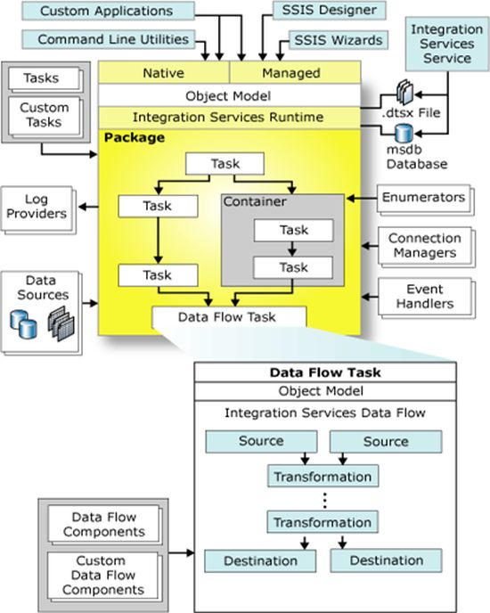
Main Components
Control Flow Engine (Integration Services Runtime)
2. Data Flow Engine (Pipeline Engine)
Image source TechNet MSDN

Slide 3
Control Flow -Key Components:
Package → Basic unit of SSIS work, saved as .dtsx files.
Tasks → Predefined operations (Execute SQL, Data Flow Task, File System Task, etc.).
Custom Tasks → User-created tasks for special requirements.
Containers → Group tasks (Sequence, For Loop, Foreach Loop).
Precedence Constraints → Control the order and conditions of execution.
Integration Services Runtime → Executes Control Flow, manages tasks,
containers, events, logging, and transactions.

Slide 4
Control Flow - Supporting Elements:
Custom Applications → Apps that run packages programmatically.
Command Line Utilities → dtexec, dtutil to run/manage packages.
Log Providers → Capture execution logs (File, SQL, XML, Event Log).
Data Sources → Reusable metadata connections.
Event Handlers → Define actions on events (OnError, OnWarning, OnTaskFailed).
Connection Managers → Define connectivity to sources/destinations (SQL, Oracle, FTP, Excel).
Enumerators → Used in Foreach Loops (files in folder, rows in recordset).
msdb Database → Stores packages deployed to SQL Server.
.dtsx Files → XML-based SSIS package definitions.
SSIS Wizards → Import/Export Wizard to create packages quickly.
SSIS Designer → Visual Studio/SSDT environment for package design.

Slide 5
Control Flow operates on three layers:
Native (C++ Runtime Engine)
Core engine of SSIS (unmanaged code).
Executes packages, tasks, memory, events, precedence constraints.
Very fast as it’s compiled code.
Managed Layer (.NET Wrapper)
Built in C#.
Bridges SSIS runtime with .NET framework.
Used for creating Custom Tasks, Log Providers, Extensions.
Object Model (Programmability Layer)
Exposes SSIS functionality as APIs.
Namespaces:
Microsoft.SqlServer.Dts.Runtime (Control Flow)
Microsoft.SqlServer.Dts.Pipeline (Data Flow)
Lets developers programmatically create/modify/run packages using C# or VB.NET.

Slide 6
Data Flow (Pipeline Engine)-Key Components:
The Data Flow Task is part of the Control Flow but handles actual data movement.
Source → Extracts data (SQL, Excel, CSV, Oracle, flat file).
Transformation → Cleans, aggregates, joins, or modifies data (Lookup, Derived Column, Merge Join, etc.).
Destination → Loads processed data (SQL Server, Data Warehouse, flat file).
Custom Data Flow Components → User-defined sources/transformations/destinations.
Pipeline Engine → Executes data flow, manages buffers, parallelism, and performance.

Slide 7
Control Flow = decides what to run and when.
Data Flow = decides how the data moves and transforms.

